Slide 1
How to Increase Life of Lead-Acid Battery ?
By
C. S. Ramanathan
Battery Consultant
ramanathancs58@gmail.com
Ph.: + 91 98450 49975

Slide 2
How to Increase Life of Battery
By controlling common modes of failure , life cycle can be enhanced.
There are several modes of failure of batteries during warranty which need to be controlled.
4 Common Modes of premature Failure and possible remedies are considered in this presentation.
Grid Failure
Shedding of Paste
Stratification of Electrolyte ( Known for long time; but practical solutions found only recently )
SULPHATION of Negative Plates
Effective Remedies are discussed in this presentation.

Slide 3
1 1 .Failure of Positive Grid and Components
Grid Corrosion is a Common Defect and a Common Failure Mode of Battery.
Corrosion build up during latter phase of charging or on continuous float , particularly at high temperature.
Grid Surface is Oxidised to PbO , a Non-Conducting Corrosion layer .
One Remedy is to use 1-1.3 % Tin in Antimonial Alloy to get a Conductive layer of PbO₂ ( Prengaman)
Tin Oxide – SnO₂ - converts PbO ( non-conductor ) to PbO₂, a Semi-Conductor.
Thin adherent conducting layer of PbO₂ is formed over grid Surface, helping facile charge and discharge over many cycles.

Slide 4
Additives to Positive Grid Alloy to Reduce Corrosion
Element | % in the Alloy | For use in Alloy Type | Cost of Element ₹ | Increase in alloy cost appox / indicative
Tin | 1-1.3 % | Lead-Antimony | 1400 /kg | 8.4 % more
Silver | 0.017 %-0.03 % | Lead-Antimony | 50.000 /kg | 8.6% more
Silver | 0.05 % with Tin < 1 % | Lead-Calcium | 50,000 /kg | 14 % more
Barium | 0.015- 0.02 % | Lead-Calcium | 19000 / kg | 2.5% more

Slide 5
Corrosion-Resistant Alloy for Positive Grids
It is suggested that High Tin be used to Lead-Antimony positive grids and components to control Corrosion . Cost of alloy increases by 8.4 % approx
Silver is very effective to control corrosion . Cost of alloy increases by approximately 8.6% .
Alloys with Silver need forced Curing .
Since good curing facility is not always available in small units, it is prudent not to use Silver in alloy. Use Silver only with good curing .
Use TIN instead.
Barium metal is added for Lead-Calcium Positive Alloys
Furukawa / SF for Maintenance –Free Auto batteries operating at under-hood temperatures of 60-65 ⁰C.
Silver with Barium in Lead-Calcium alloy is an excellent choice.

Slide 6
2. Plate Shedding - Causes & Remedies
Poor Curing is main cause of shedding. Smooth grid surface , oil on grids , low moisture in paste cause poor curing and poor adhesion between Grid and Paste.
Tetrabasic Lead Sulphate ( 4 BS; 4 PbO, PbSO₄) in Positive paste and curing at high Temperature and High RH is a remedy. A strong porous skeleton is obtained.
4 BS can be obtained during paste mixing at 70⁰C-80 ⁰ C. But this process is not practical for SMEs .
Also large crystals of 4BS take longer time for formation.
Instead , add seed crystals of 4BS to paste and cure at 56 ⁰ C under 98-100 % RH( Procedure of Hammond Lead Products). Choose particle size as small as available.
Live steam from Boiler is ideal for Curing . Conditioned Chambers also can give High Temperature and High RH.
Use DROP TEST for evaluation of Adhesion and Cohesion.

Slide 7
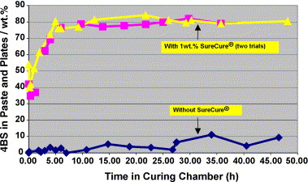
% 4BS in curing at 54°C with seed crystals in paste . [ Data of Hammond Lead Products]

Slide 8
Fibres, Polyester Fleece, Tight Assembly
Addition of Fibres to paste for reinforcement is well –known and is in use since several decades. Fibre helps to prevent shedding during handling of plates on the shop floor .
In VRLA batteries, use of thin glass mat of about 35 gsm ( H&V) on freshly pasted positive plate is also well –known .
ENHANCED FLOODED BATTERIES ( EFB) use a woven polyester fleece ‘SCRIM’ which is placed on top of freshly pasted positives and embedded in it.
One factor for Longer Life of EFB batteries is the Scrim.
However, SCRIM is not compatible with open formation since the scrim will de-bond and fall off in formation tank.
Use scrim on positive when green plate formation is used.
Tight assembly of plates (Sandwich box) already being used by many units prevents expansion and prevents shedding.

Slide 9
Control of Stratification in Flooded Batteries
Stratification or Settling of higher density acid to the bottom of plate by gravity, in flooded batteries is a well- known phenomenon for decades.
But its Life-Limiting effect is not so well recognised /appreciated.
Density of acid differs significantly between Top and Bottom layers soon after charging .
Recent comparison of Flooded & VRLA shows that VRLA can withstand charge –discharge cycles significantly more than conventional Flooded. This is due to reduced STRATIFICATION of acid in VRLA Batteries. (Capillary forces/wicking action)
VRLA-AGM has immobilised electrolyte with no ‘FREE’ electrolyte. VRLA -GEL is even better in this respect.
How to remove stratification and get longer life ?

Slide 10
Stratification in Flooded Batteries- Settling of higher Density acid by Gravity
Recent studies show that stratification starts soon after charge. Bottom of plate shows a higher acid density and higher OCV; while top of plate has lower density and lower OCV
EMF differs between top and bottom of plates. A concentration cell is formed within each plate .
An internal CHARGE BALANCING occurs between top and bottom of each plate.
PbSO₄ in bottom layer grows resulting in SULPHATION. Large Crystals do not readily accept charge.
Life of plate is compromised.
Inverter batteries use tall plates and are more prone to stratification. Lower portion of batteries suffer SULPHATION

Slide 11
Remedies for Stratification in Flooded Batteries
Inverter and Stationary Batteries
Stratification of Inverter and Stationary Batteries can be controlled by frequent Gassing Charge.(1-2 times per week)
Usual Cut-off Voltages of 13.8- 14.2 Volts are insufficient for good gassing charge.
Additional provision to charge beyond 15.5-16 V should be provided. Charging duration can be about 30 minutes to 1 hr.
A substantial benefit is longer cycle life of battery.
Automotive and E-Rickshaw Batteries
In Automotive battery , Float Voltage more than 14.4 V is obviously not possible /acceptable. The electrical appliances cannot accept more than 15 V.
A Remedy is to use an inverted L-shaped Tube which helps to mix acid during motion of Vehicle (as in EFBs used in Europe and Japan in Stop-Start Applications) to control stratification .

Slide 12
Acid Circulation within cell for Auto and E-Rickshaw Batteries using Passive Device
A Passive Device made of plastic with inverted L-shape and vertical tubes for flow of acid up and down.
Acid backs up on opposite sides of Cell wall during movement. Bottom Acid in cell flows up during acceleration and top acid flows down during deceleration through the vertical tubes.
Acid is thus continuously circulated while running.
Uniform Density of Acid is maintained and lower parts of plate do not undergo higher Sulphation.
Significant discharges occur in Auto Battery with Air-Conditioner, other electrical loads working during stops and idling at Traffic Lights, bumper-bumper driving etc .
Mixing is better when battery is so installed that longer side is at right angles to the direction of vehicle movement.

Slide 13
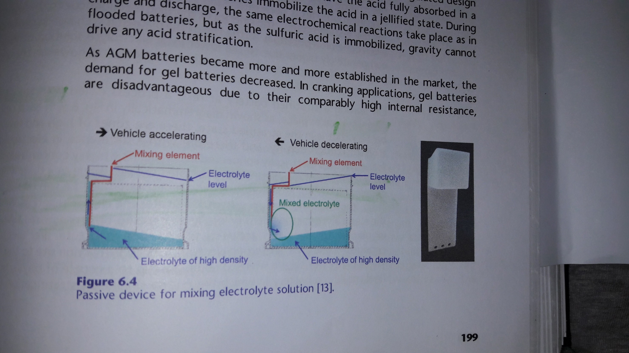
Acid flow during Acceleration and Deceleration Ebner, Wark, Boerger ; Chem. Ing.Tech 83, ( 2013) 2051

Slide 14
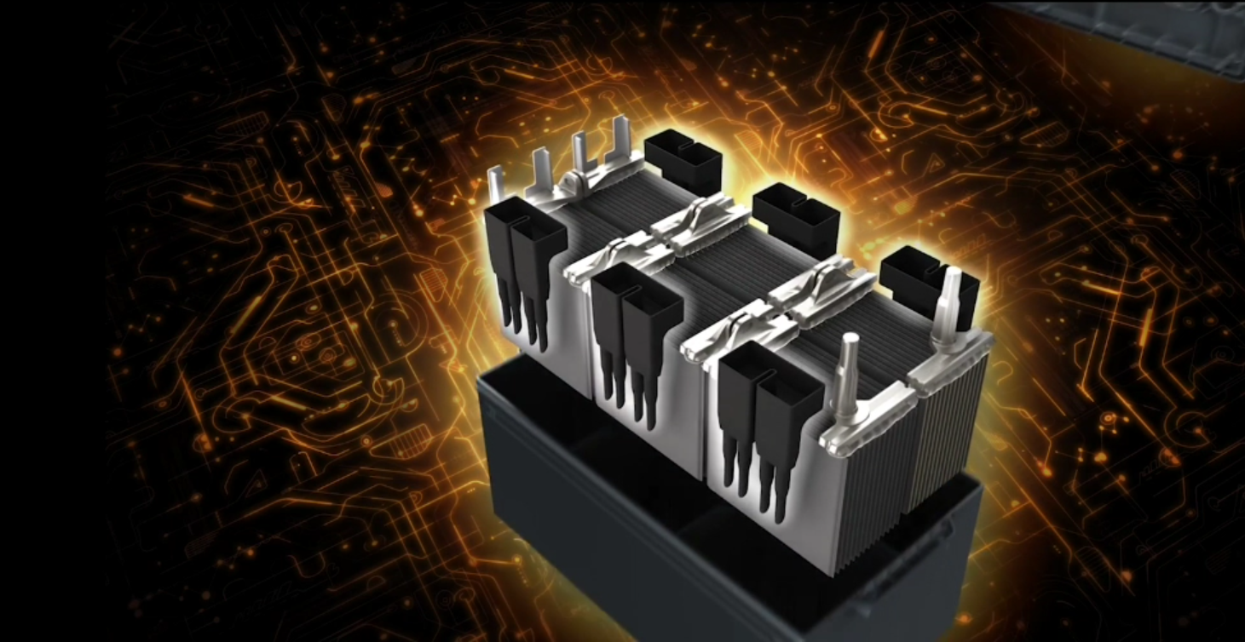
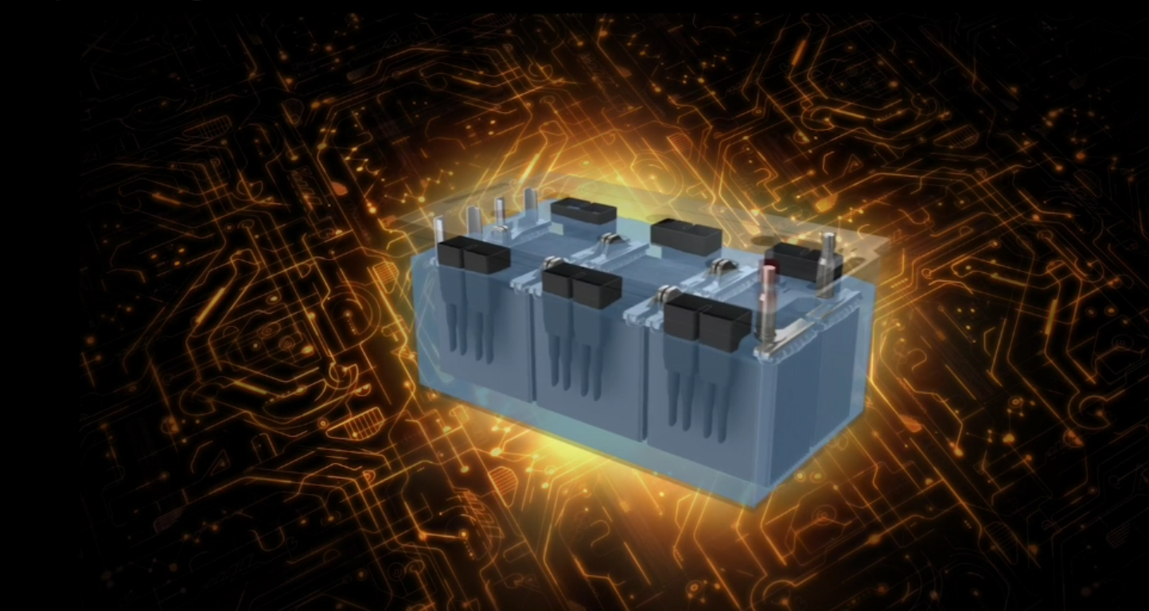
Mixing Element During Acceleration and Deceleration of Vehicle

Slide 15
4. Sulphation of Negative and Remedies
Sulphation of Negative is a slow process .
It is built -up during Discharge /Charge cycles. Every recharge does not result in 100 % conversion due to poor charge acceptance of Negative.
A small percentage of Lead Sulphate is not charged back during every cycle of Discharge /Charge.
Hence build-up of Lead Sulphate results. The crystals grow over time (Ostwald Ripening) and resist charge.
This is called SULPHATION.
ALABC researchers found a solution - Use Special Carbons – Graphite , Carbon Blacks, Nanotubes in Negative Paste to improve charge acceptance and control Sulphation .
Batteries of interest are Auto , E-Rickshaw and Inverter.

Slide 16
Graphite
Graphite is preferably added at 2% level to Negative Paste. It improves charge acceptance to a large extent.
The major advantage of Graphite is its high top -of- Charge voltage and Low Gassing.
There are many Manufacturers like Superior Graphite ( US/China) , Timcal ,Europe ( Synthetic) and others.
Expanded Graphites like ABG 1010 are also good.
Graphites act as Supercapacitors. They accept charge and distribute the charge to the lead branches of NAM .
Thus charge acceptance is increased.

Slide 17
Carbon Blacks
Carbon Blacks are added at 0.3 -0.5% level.
Top-of –Charge is low and gassing is reported with some Carbon Blacks at higher levels.
Extensive testing should be carried out before using a given Carbon Black. Otherwise gassing may result.
Pavlov procedure can be used for evaluation . Details of test are given in my book .
Carbon Blacks can be safely used in VRLA batteries since the charge cut – off voltage is Low ( 13.5V- 14.2 V )
CBs can also be used in flooded Batteries like Traction , E-Rickshaw where top–up with water is acceptable.

Slide 18
Choosing Carbon- Pavlov
Condition battery by 3 Charge/Discharge cycles .
Charge battery to 14.4 V . Calculate AH input and Duration .
Discharge the battery and determine its AH Capacity.
Charge battery to 14.3 V . Calculate AH input and Duration .
Discharge the battery and determine its AH capacity.
Repeat above steps charging to 14.2 V, 14.1 V and 14.0 V
Compare capacities for different charge voltages and see which charge voltage gives 80% AH.
Charge battery at this voltage to determine the duration of charge needed until the battery is fully charged.
If this end-of-charge voltage turns out to be insufficient, increase it a bit or change the Carbon used.
Try another grade of Carbon Black.

Slide 19
Summary
Use Corrosion –Resistant Alloy for Positive Grids and components
Add Tetrabasic Lead Sulphate (4BS) seed crystals to positive paste to build strong skeleton .
Control shedding by good curing at high Temperature and High Relative Humidity ,preferably with Live Steam. Maintain minimum 10 % moisture at start of curing.
Add advanced Carbons- Graphite and Carbon Blacks to Negative Paste to control Sulphation .
Cost of Corrosion –resistant alloy is higher; but cost of negative paste is less due to lesser paste weights, partially reducing cost.
Consider use of SCRIM and Acid Mixing Device in Auto and E-Rickshaw batteries.

Slide 20
THANK YOU

